Slide 1
CS 300- Storage Management
Module-IV

Slide 2
Overview of Mass Storage Structure
Magnetic disks provide bulk of secondary storage of modern computers
Drives rotate at 60 to 250 times per second
Transfer rate is rate at which data flow between drive and computer
Positioning time (random-access time) is time to move disk arm to desired cylinder (seek time) and time for desired sector to rotate under the disk head (rotational latency)
Head crash results from disk head making contact with the disk surface -- That’s bad
Disks can be removable

Slide 3
Moving-head Disk Mechanism

Slide 4
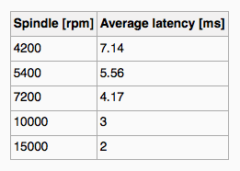
Hard Disks
Platters range from .85” to 14” (historically)
Commonly 3.5”, 2.5”, and 1.8”
Range from 30GB to 3TB per drive
Performance
Transfer Rate – theoretical – 6 Gb/sec
Effective Transfer Rate – real – 1Gb/sec
Seek time from 3ms to 12ms – 9ms common for desktop drives
Average seek time measured or calculated based on 1/3 of tracks
Latency based on spindle speed
1 / (RPM / 60) = 60 / RPM
Average latency = ½ latency
(From Wikipedia)

Slide 5
Hard Disk Performance
Access Latency = Average access time = average seek time + average latency
For fastest disk 3ms + 2ms = 5ms
For slow disk 9ms + 5.56ms = 14.56ms
Average I/O time = average access time + (amount to transfer / transfer rate) + controller overhead

Slide 6
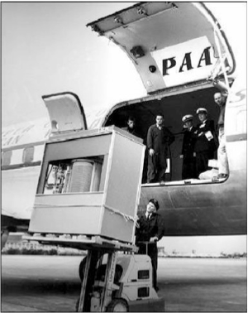
The First Commercial Disk Drive
1956
IBM RAMDAC computer included the IBM Model 350 disk storage system
5M (7 bit) characters
50 x 24” platters
Access time = < 1 second

Slide 7
Solid-State Disks
Nonvolatile memory used like a hard drive
Many technology variations
Can be more reliable than HDDs
More expensive per MB
Maybe have shorter life span
Less capacity
But much faster
No moving parts, so no seek time or rotational latency

Slide 8
Magnetic Tape
Was early secondary-storage medium
Evolved from open spools to cartridges
Relatively permanent and holds large quantities of data
Access time slow
Random access ~1000 times slower than disk
Mainly used for backup, storage of infrequently-used data, transfer medium between systems
Kept in spool and wound or rewound past read-write head
Once data under head, transfer rates comparable to disk
140MB/sec and greater
200GB to 1.5TB typical storage
Common technologies are LTO-{3,4,5} and T10000

Slide 9
Disk Structure
Disk drives are addressed as large 1-dimensional arrays of logical blocks, where the logical block is the smallest unit of transfer
Low-level formatting creates logical blocks on physical media
The 1-dimensional array of logical blocks is mapped into the sectors of the disk sequentially
Sector 0 is the first sector of the first track on the outermost cylinder
Mapping proceeds in order through that track, then the rest of the tracks in that cylinder, and then through the rest of the cylinders from outermost to innermost
Logical to physical address should be easy
Except for bad sectors
Non-constant # of sectors per track via constant angular velocity

Slide 10
Storage Array
Can just attach disks, or arrays of disks
Storage Array has controller(s), provides features to attached host(s)
Ports to connect hosts to array
Memory, controlling software (sometimes NVRAM, etc)
A few to thousands of disks
RAID, hot spares, hot swap
Shared storage -> more efficiency
Features found in some file systems
Snaphots, clones, thin provisioning, replication, deduplication, etc

Slide 11
Storage Area Network
Common in large storage environments
Multiple hosts attached to multiple storage arrays - flexible

Slide 12
Storage Area Network (Cont.)
SAN is one or more storage arrays
Connected to one or more Fibre Channel switches
Hosts also attach to the switches
Easy to add or remove storage, add new host and allocate it storage
Over low-latency Fibre Channel fabric

Slide 13
Network-Attached Storage
Network-attached storage (NAS) is storage made available over a network rather than over a local connection (such as a bus)
Remotely attaching to file systems
Implemented via remote procedure calls (RPCs) between host and storage over typically TCP or UDP on IP network
iSCSI protocol uses IP network to carry the SCSI protocol
Remotely attaching to devices (blocks)

Slide 14
Disk Scheduling
The operating system is responsible for using hardware efficiently — for the disk drives, this means having a fast access time and disk bandwidth
Minimize seek time
Seek time ≈ seek distance
Disk bandwidth is the total number of bytes transferred, divided by the total time between the first request for service and the completion of the last transfer

Slide 15
Disk Scheduling (Cont.)
There are many sources of disk I/O request
OS
System processes
Users processes
I/O request includes input or output mode, disk address, memory address, number of sectors to transfer
OS maintains queue of requests, per disk or device
Idle disk can immediately work on I/O request, busy disk means work must queue
Optimization algorithms only make sense when a queue exists

Slide 16
Disk Scheduling (Cont.)
Note that drive controllers have small buffers and can manage a queue of I/O requests (of varying “depth”)
Several algorithms exist to schedule the servicing of disk I/O requests
The analysis is true for one or many platters
Consider a request queue (0-199)
98, 183, 37, 122, 14, 124, 65, 67
Head pointer 53

Slide 17
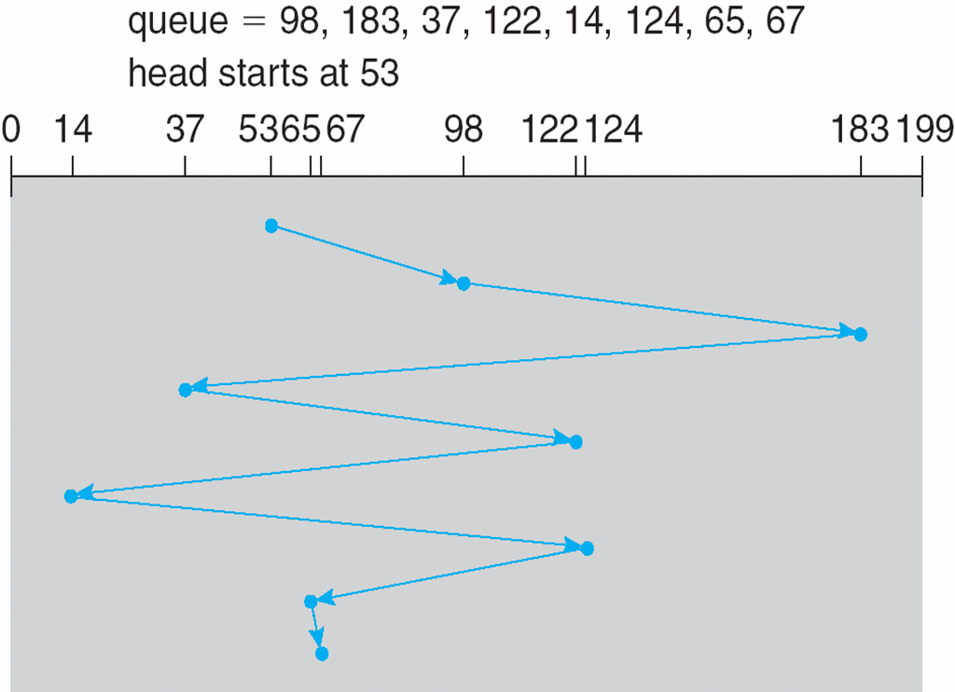
FCFS
Illustration shows total head movement of 640 cylinders

Slide 18
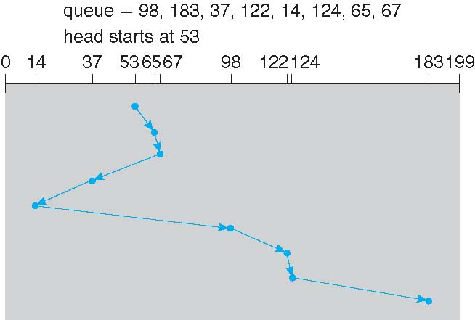
SSTF
Shortest Seek Time First selects the request with the minimum seek time from the current head position
SSTF scheduling is a form of SJF scheduling; may cause starvation of some requests
Illustration shows total head movement of 236 cylinders

Slide 19
SCAN
The disk arm starts at one end of the disk, and moves toward the other end, servicing requests until it gets to the other end of the disk, where the head movement is reversed and servicing continues.
SCAN algorithm Sometimes called the elevator algorithm
Illustration shows total head movement of 236 cylinders
But note that if requests are uniformly dense, largest density at other end of disk and those wait the longest

Slide 20
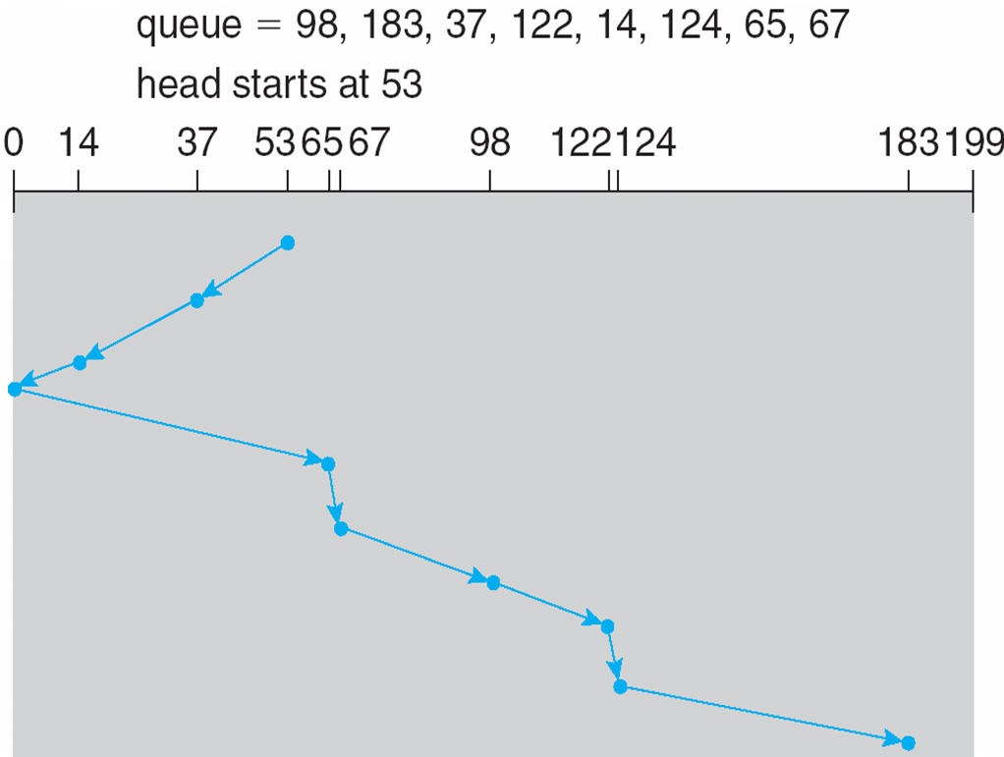
SCAN (Cont.)

Slide 21
C-SCAN
Provides a more uniform wait time than SCAN
The head moves from one end of the disk to the other, servicing requests as it goes
When it reaches the other end, however, it immediately returns to the beginning of the disk, without servicing any requests on the return trip
Treats the cylinders as a circular list that wraps around from the last cylinder to the first one
Total number of cylinders?

Slide 22
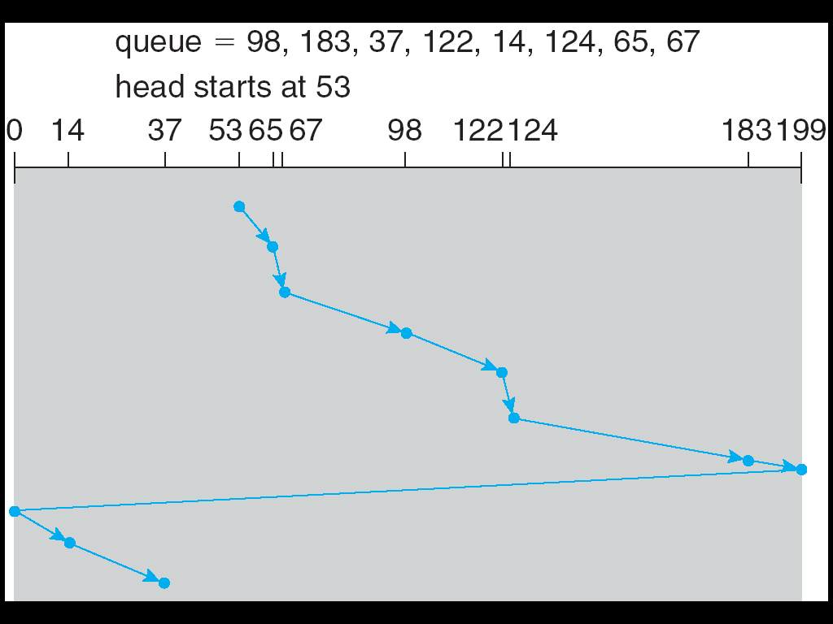
C-SCAN (Cont.)

Slide 23
C-LOOK
LOOK a version of SCAN, C-LOOK a version of C-SCAN
Arm only goes as far as the last request in each direction, then reverses direction immediately, without first going all the way to the end of the disk
Total number of cylinders?

Slide 24
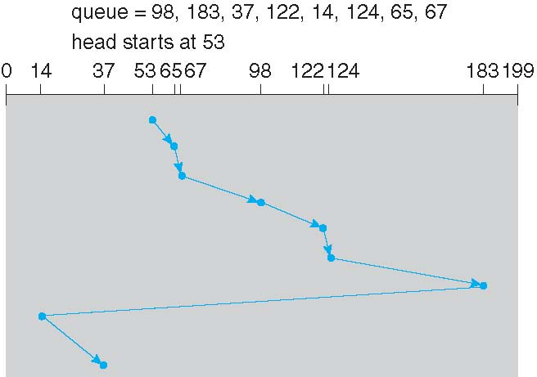
C-LOOK (Cont.)

Slide 25
Selecting a Disk-Scheduling Algorithm
SSTF is common and has a natural appeal
SCAN and C-SCAN perform better for systems that place a heavy load on the disk - Less starvation
Performance depends on the number and types of requests
Requests for disk service can be influenced by the file-allocation method
And metadata layout
The disk-scheduling algorithm should be written as a separate module of the operating system, allowing it to be replaced with a different algorithm if necessary
Either SSTF or LOOK is a reasonable choice for the default algorithm
What about rotational latency?
Difficult for OS to calculate

Slide 26
Disk Management
Low-level formatting, or physical formatting — Dividing a disk into sectors that the disk controller can read and write
Each sector can hold header information, plus data, plus error correction code (ECC)
Usually 512 bytes of data but can be selectable
To use a disk to hold files, the operating system still needs to record its own data structures on the disk
Partition the disk into one or more groups of cylinders, each treated as a logical disk
Logical formatting or “making a file system”
To increase efficiency most file systems group blocks into clusters
Disk I/O done in blocks
File I/O done in clusters

Slide 27
Disk Management (Cont.)
Raw disk access for apps that want to do their own block management, keep OS out of the way (databases for example)
Boot block initializes system
The bootstrap is stored in ROM
Bootstrap loader program stored in boot blocks of boot partition

Slide 28
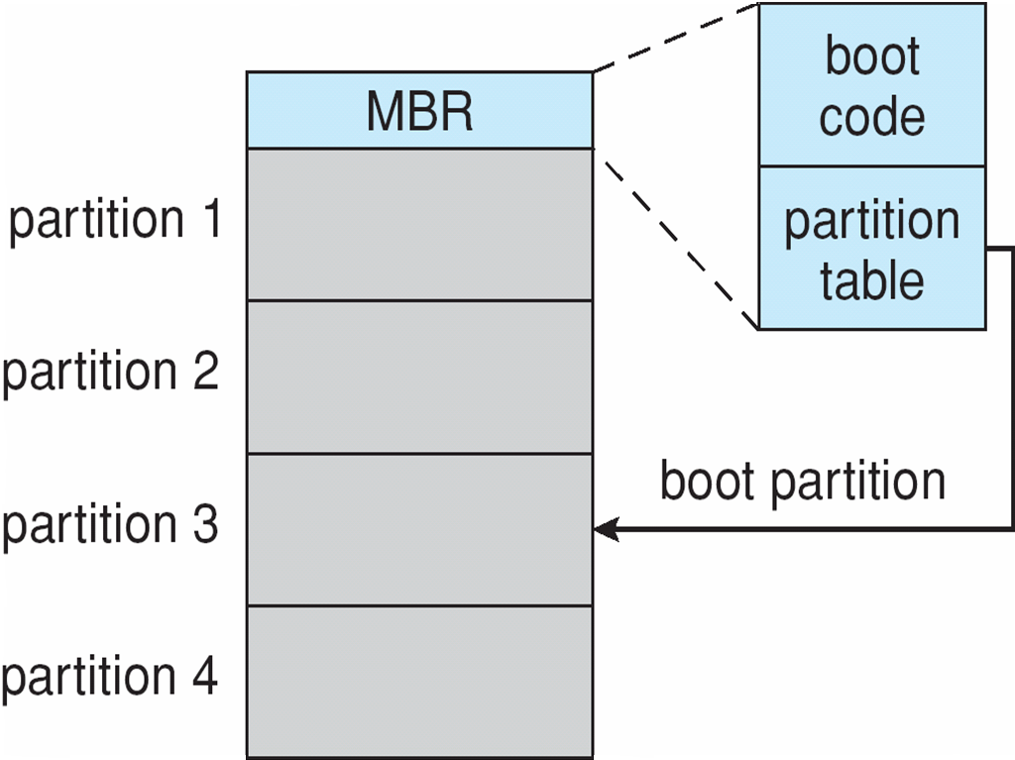
Booting from a Disk in Windows

Slide 29
Swap-Space Management
Swap-space — Virtual memory uses disk space as an extension of main memory
Less common now due to memory capacity increases
Swap-space can be carved out of the normal file system, or, more commonly, it can be in a separate disk partition (raw)
Swap-space management
4.3BSD allocates swap space when process starts; holds text segment (the program) and data segment
Kernel uses swap maps to track swap-space use
Solaris 2 allocates swap space only when a dirty page is forced out of physical memory, not when the virtual memory page is first created
File data written to swap space until write to file system requested
Other dirty pages go to swap space due to no other home
Text segment pages thrown out and reread from the file system as needed
What if a system runs out of swap space?
Some systems allow multiple swap spaces

Slide 30
Data Structures for Swapping on Linux Systems

Slide 31
RAID Structure
RAID – redundant array of inexpensive disks
multiple disk drives provides reliability via redundancy
Increases the mean time to failure
Mean time to repair – exposure time when another failure could cause data loss
Mean time to data loss based on above factors
If mirrored disks fail independently, consider disk with 100,000 mean time to failure and 10 hour mean time to repair
Mean time to data loss is 100, 000² / (2 ∗ 10) = 500 ∗ 10⁶ hours, or 57,000 years!
Frequently combined with NVRAM to improve write performance
Several improvements in disk-use techniques involve the use of multiple disks working cooperatively

Slide 32
RAID (Cont.)
Disk striping uses a group of disks as one storage unit
RAID is arranged into six different levels
RAID schemes improve performance and improve the reliability of the storage system by storing redundant data
Mirroring or shadowing (RAID 1) keeps duplicate of each disk
Striped mirrors (RAID 1+0) or mirrored stripes (RAID 0+1) provides high performance and high reliability
Block interleaved parity (RAID 4, 5, 6) uses much less redundancy
RAID within a storage array can still fail if the array fails, so automatic replication of the data between arrays is common
Frequently, a small number of hot-spare disks are left unallocated, automatically replacing a failed disk and having data rebuilt onto them

Slide 33
RAID Levels

Slide 34
RAID (0 + 1) and (1 + 0)

Slide 35
File Concept
Contiguous logical address space
Types:
Data
numeric
character
binary
Program
Contents defined by file’s creator
Many types
Consider text file, source file, executable file

Slide 36
File Attributes
Name – only information kept in human-readable form
Identifier – unique tag (number) identifies file within file system
Type – needed for systems that support different types
Location – pointer to file location on device
Size – current file size
Protection – controls who can do reading, writing, executing
Time, date, and user identification – data for protection, security, and usage monitoring
Information about files are kept in the directory structure, which is maintained on the disk
Many variations, including extended file attributes such as file checksum
Information kept in the directory structure

Slide 37
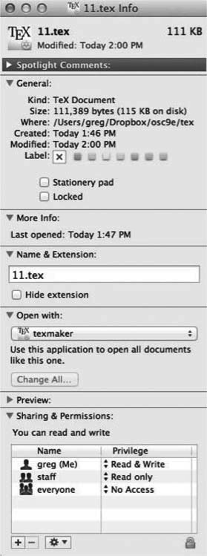
File info Window on Mac OS X

Slide 38
File Operations
File is an abstract data type
Create
Write – at write pointer location
Read – at read pointer location
Reposition within file - seek
Delete
Truncate
Open(F_{i}) – search the directory structure on disk for entry F_{i}, and move the content of entry to memory
Close (F_{i}) – move the content of entry F_{i} in memory to directory structure on disk

Slide 39
Open Files
Several pieces of data are needed to manage open files:
Open-file table: tracks open files
File pointer: pointer to last read/write location, per process that has the file open
File-open count: counter of number of times a file is open – to allow removal of data from open-file table when last processes closes it
Disk location of the file: cache of data access information
Access rights: per-process access mode information

Slide 40
Open File Locking
Provided by some operating systems and file systems
Similar to reader-writer locks
Shared lock similar to reader lock – several processes can acquire concurrently
Exclusive lock similar to writer lock
Mediates access to a file
Mandatory or advisory:
Mandatory – access is denied depending on locks held and requested
Advisory – processes can find status of locks and decide what to do

Slide 41
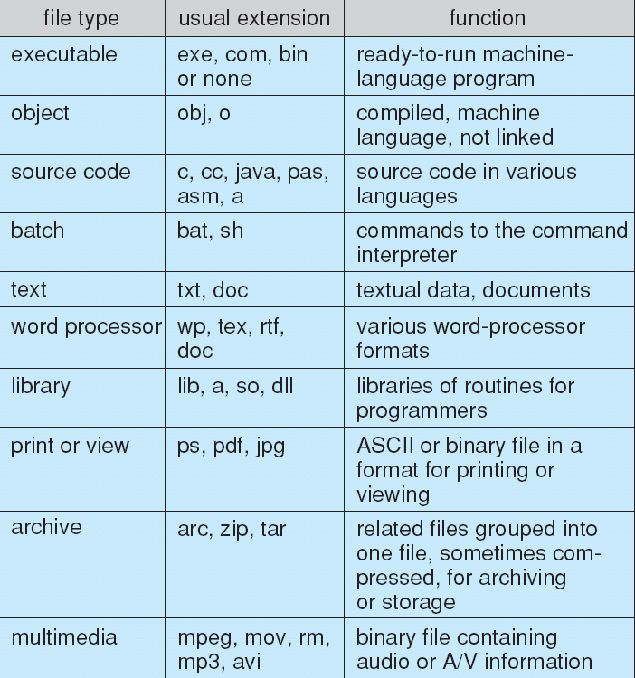
File Types – Name, Extension

Slide 42
File Structure
None - sequence of words, bytes
Simple record structure
Lines
Fixed length
Variable length
Complex Structures
Formatted document
Relocatable load file
Can simulate last two with first method by inserting appropriate control characters
Who decides:
Operating system
Program

Slide 43
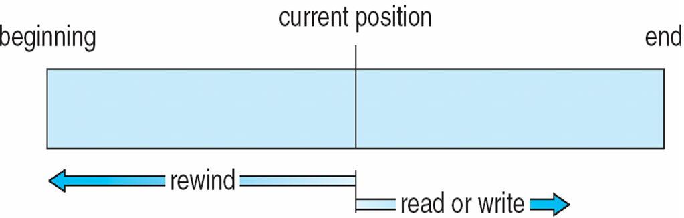
Sequential-access File

Slide 44
Access Methods
Sequential Access
read next
write next
reset
no read after last write
(rewrite)
Direct Access – file is fixed length logical records
read n
write n
position to n
read next
write next
rewrite n
n = relative block number
Relative block numbers allow OS to decide where file should be placed

Slide 45
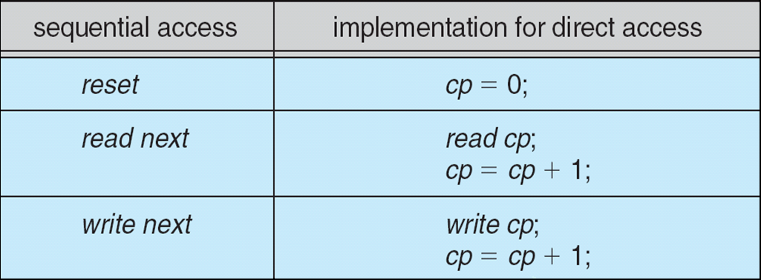
Simulation of Sequential Access on Direct-access File

Slide 46
Other Access Methods
Can be built on top of base methods
General involve creation of an index for the file
Keep index in memory for fast determination of location of data to be operated on
If too large, index (in memory) of the index (on disk)

Slide 47
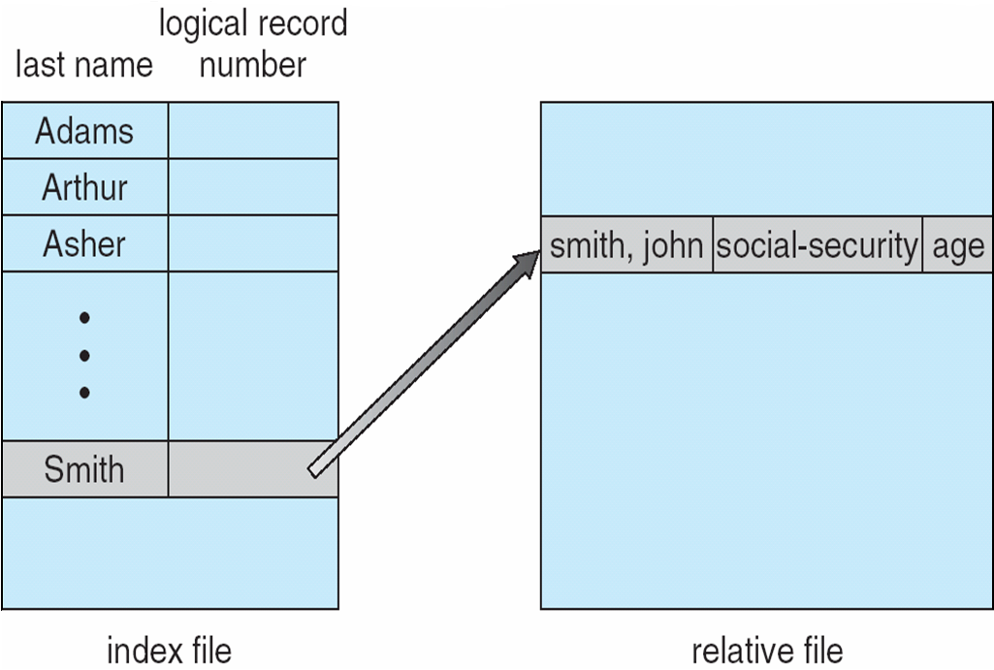
Example of Index and Relative Files

Slide 48
Directory Structure
A collection of nodes containing information about all files
Directory
Files
F 1
F 2
F 3
F 4
F n
Both the directory structure and the files reside on disk

Slide 49
Disk Structure
Disk can be subdivided into partitions
Disks or partitions can be RAID protected against failure
Disk or partition can be used raw – without a file system, or formatted with a file system
Partitions also known as minidisks, slices
Entity containing file system known as a volume
Each volume containing file system also tracks that file system’s info in device directory or volume table of contents
As well as general-purpose file systems there are many special-purpose file systems, frequently all within the same operating system or computer

Slide 50
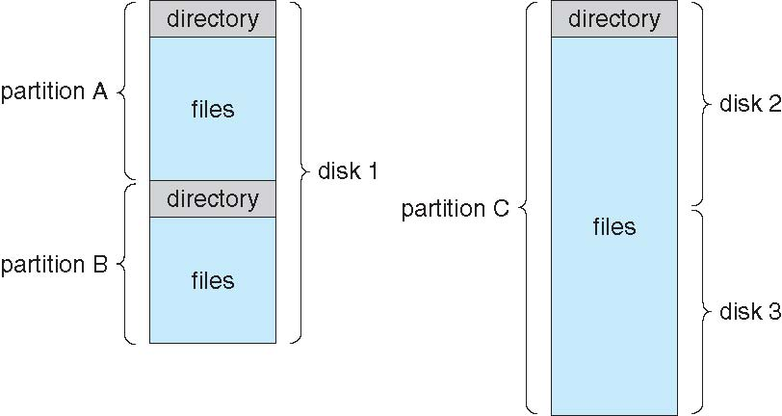
A Typical File-system Organization

Slide 51
Operations Performed on Directory
Search for a file
Create a file
Delete a file
List a directory
Rename a file
Traverse the file system

Slide 52
Directory Organization
The directory is organized logically to obtain
Efficiency – locating a file quickly
Naming – convenient to users
Two users can have same name for different files
The same file can have several different names
Grouping – logical grouping of files by properties, (e.g., all Java programs, all games, …)

Slide 53
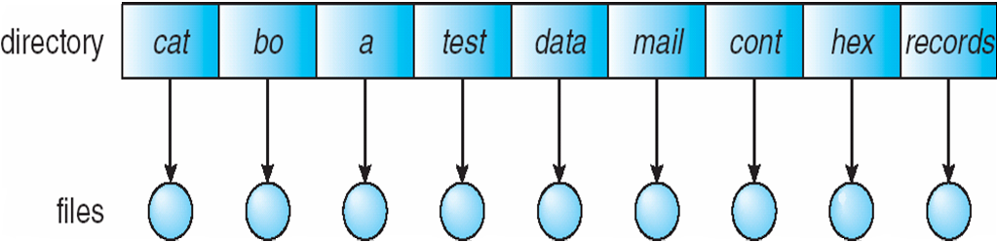
Single-Level Directory
A single directory for all users
Naming problem
Grouping problem

Slide 54
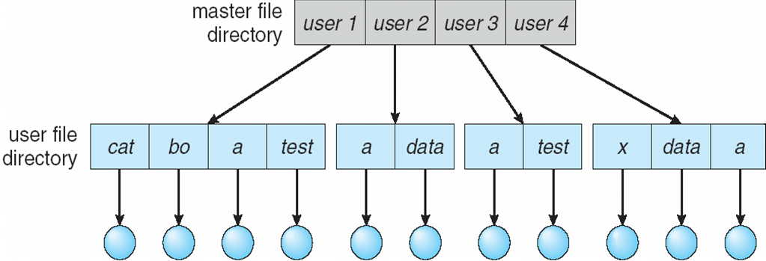
Two-Level Directory
Separate directory for each user
Path name
Can have the same file name for different user
Efficient searching
No grouping capability

Slide 55
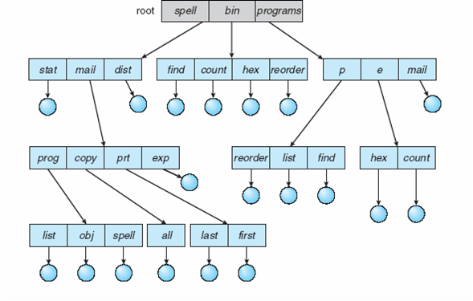
Tree-Structured Directories

Slide 56
Tree-Structured Directories (Cont.)
Efficient searching
Grouping Capability
Current directory (working directory)
cd /spell/mail/prog
type list

Slide 57
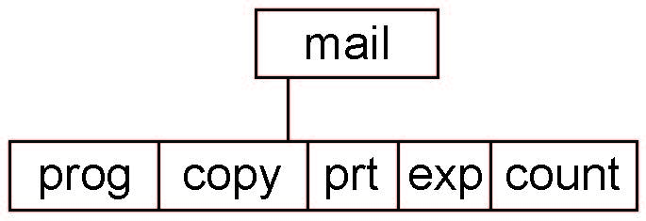
Tree-Structured Directories (Cont)
Absolute or relative path name
Creating a new file is done in current directory
Delete a file
rm <file-name>
Creating a new subdirectory is done in current directory
mkdir <dir-name>
Example: if in current directory /mail
mkdir count
Deleting “mail” ⇒ deleting the entire subtree rooted by “mail”

Slide 58
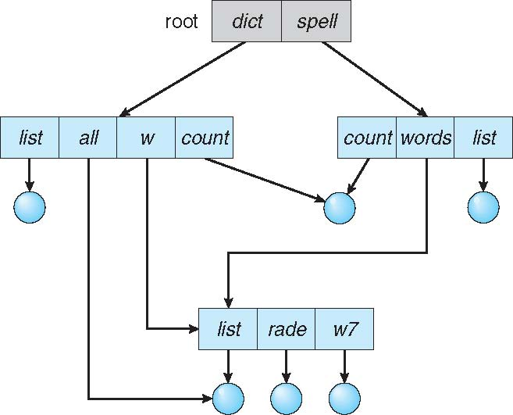
Acyclic-Graph Directories
Have shared subdirectories and files

Slide 59
Acyclic-Graph Directories (Cont.)
Two different names (aliasing)
A file may now have multiple absolute path names
If dict deletes list ⇒ dangling pointer
Solutions:
Backpointers, so we can delete all pointers Variable size records a problem
Backpointers using a daisy chain organization
Entry-hold-count solution
New directory entry type
Link – another name (pointer) to an existing file
Resolve the link – follow pointer to locate the file

Slide 60
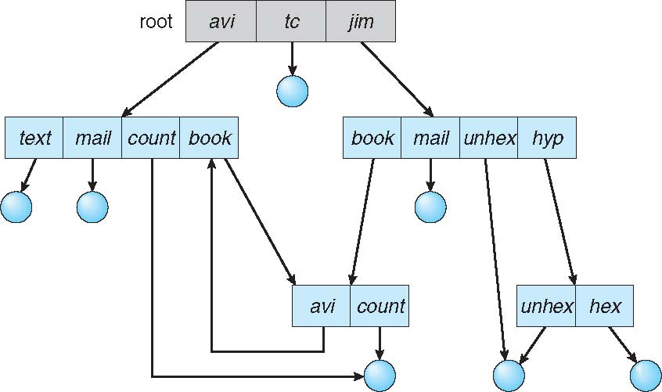
General Graph Directory

Slide 61
General Graph Directory (Cont.)
How do we guarantee no cycles?
Allow only links to file not subdirectories
Garbage collection
Every time a new link is added, use a cycle detection algorithm to determine whether it is OK

Slide 62
File System Mounting
A file system must be mounted before it can be accessed
A unmounted file system is mounted at a mount point

Slide 63
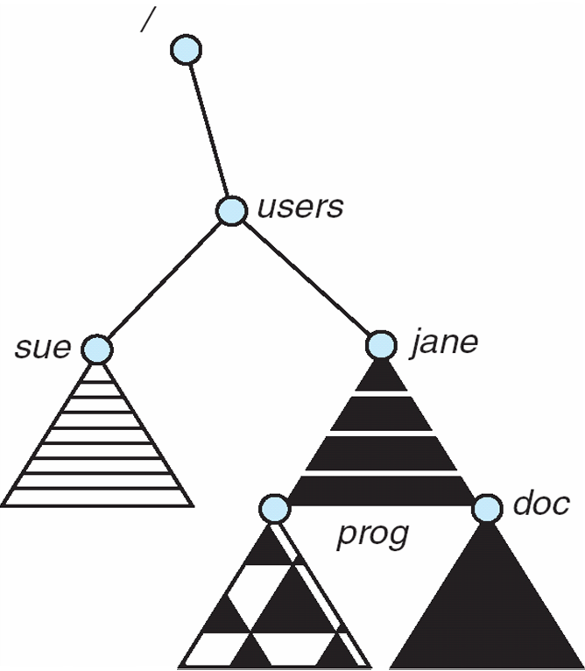
Mount Point

Slide 64
File Sharing
Sharing of files on multi-user systems is desirable
Sharing may be done through a protection scheme
On distributed systems, files may be shared across a network
Network File System (NFS) is a common distributed file-sharing method
If multi-user system
User IDs identify users, allowing permissions and protections to be per-user Group IDs allow users to be in groups, permitting group access rights
Owner of a file / directory
Group of a file / directory

Slide 65
File Sharing – Remote File Systems
Uses networking to allow file system access between systems
Manually via programs like FTP
Automatically, seamlessly using distributed file systems
Semi automatically via the world wide web
Client-server model allows clients to mount remote file systems from servers
Server can serve multiple clients
Client and user-on-client identification is insecure or complicated
NFS is standard UNIX client-server file sharing protocol
CIFS is standard Windows protocol
Standard operating system file calls are translated into remote calls
Distributed Information Systems (distributed naming services) such as LDAP, DNS, NIS, Active Directory implement unified access to information needed for remote computing

Slide 66
File Sharing – Failure Modes
All file systems have failure modes
For example corruption of directory structures or other non-user data, called metadata
Remote file systems add new failure modes, due to network failure, server failure
Recovery from failure can involve state information about status of each remote request
Stateless protocols such as NFS v3 include all information in each request, allowing easy recovery but less security

Slide 67
File Sharing – Consistency Semantics
Specify how multiple users are to access a shared file simultaneously
Similar to process synchronization algorithms
Tend to be less complex due to disk I/O and network latency (for remote file systems)
Andrew File System (AFS) implemented complex remote file sharing semantics
Unix file system (UFS) implements:
Writes to an open file visible immediately to other users of the same open file
Sharing file pointer to allow multiple users to read and write concurrently
AFS has session semantics
Writes only visible to sessions starting after the file is closed

Slide 68
Protection
File owner/creator should be able to control:
what can be done
by whom
Types of access
Read
Write
Execute
Append
Delete
List

Slide 69
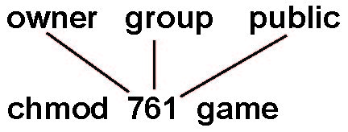
Access Lists and Groups
Mode of access: read, write, execute
Three classes of users on Unix / Linux
RWX
a) owner access 7 ⇒ 1 1 1 RWX
b) group access 6 ⇒ 1 1 0
RWX
c) public access 1 ⇒ 0 0 1
Ask manager to create a group (unique name), say G, and add some users to the group.
For a particular file (say game) or subdirectory, define an appropriate access.
Attach a group to a file chgrp G game

Slide 70
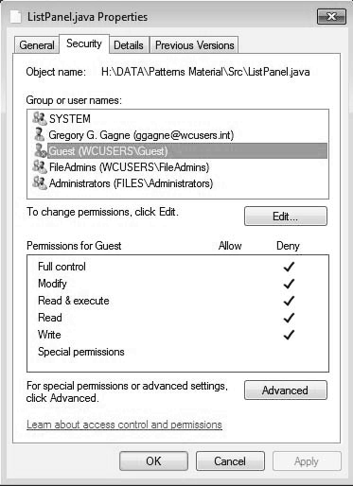
Windows 7 Access-Control List Management

Slide 71
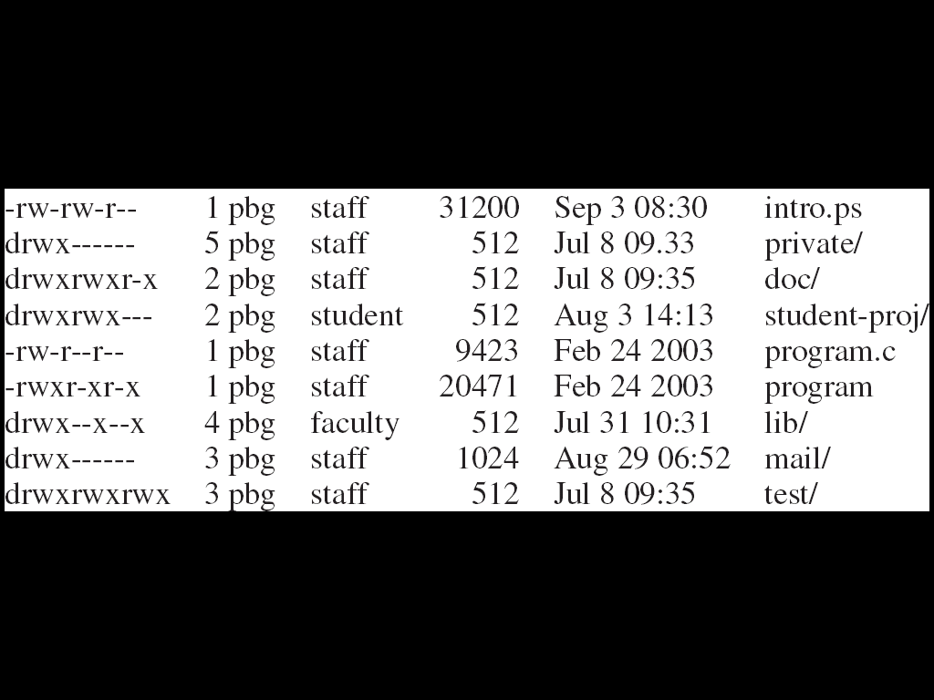
A Sample UNIX Directory Listing

Slide 72
File-System Structure
File structure
Logical storage unit
Collection of related information
File system resides on secondary storage (disks)
Provided user interface to storage, mapping logical to physical
Provides efficient and convenient access to disk by allowing data to be stored, located retrieved easily
Disk provides in-place rewrite and random access
I/O transfers performed in blocks of sectors (usually 512 bytes)
File control block – storage structure consisting of information about a file
Device driver controls the physical device
File system organized into layers

Slide 73
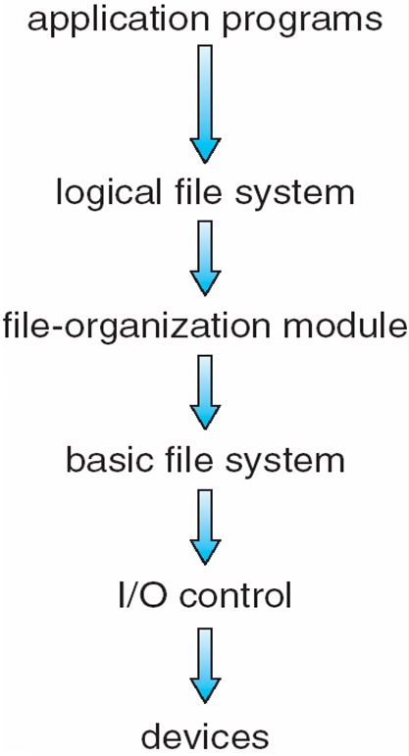
Layered File System

Slide 74
File System Layers
Device drivers manage I/O devices at the I/O control layer
Given commands like “read drive1, cylinder 72, track 2, sector 10, into memory location 1060” outputs low-level hardware specific commands to hardware controller
Basic file system given command like “retrieve block 123” translates to device driver
Also manages memory buffers and caches (allocation, freeing, replacement)
Buffers hold data in transit
Caches hold frequently used data
File organization module understands files, logical address, and physical blocks
Translates logical block # to physical block #
Manages free space, disk allocation

Slide 75
File System Layers (Cont.)
Logical file system manages metadata information
Translates file name into file number, file handle, location by maintaining file control blocks (inodes in UNIX)
Directory management
Protection
Layering useful for reducing complexity and redundancy, but adds overhead and can decrease performance
Translates file name into file number, file handle, location by maintaining file control blocks (inodes in UNIX)
Logical layers can be implemented by any coding method according to OS designer

Slide 76
File System Layers (Cont.)
Many file systems, sometimes many within an operating system
Each with its own format (CD-ROM is ISO 9660; Unix has UFS, FFS; Windows has FAT, FAT32, NTFS as well as floppy, CD, DVD Blu-ray, Linux has more than 40 types, with extended file system ext2 and ext3 leading; plus distributed file systems, etc.)
New ones still arriving – ZFS, GoogleFS, Oracle ASM, FUSE

Slide 77
File-System Implementation
We have system calls at the API level, but how do we implement their functions?
On-disk and in-memory structures
Boot control block contains info needed by system to boot OS from that volume
Needed if volume contains OS, usually first block of volume
Volume control block (superblock, master file table) contains volume details
Total # of blocks, # of free blocks, block size, free block pointers or array
Directory structure organizes the files
Names and inode numbers, master file table

Slide 78
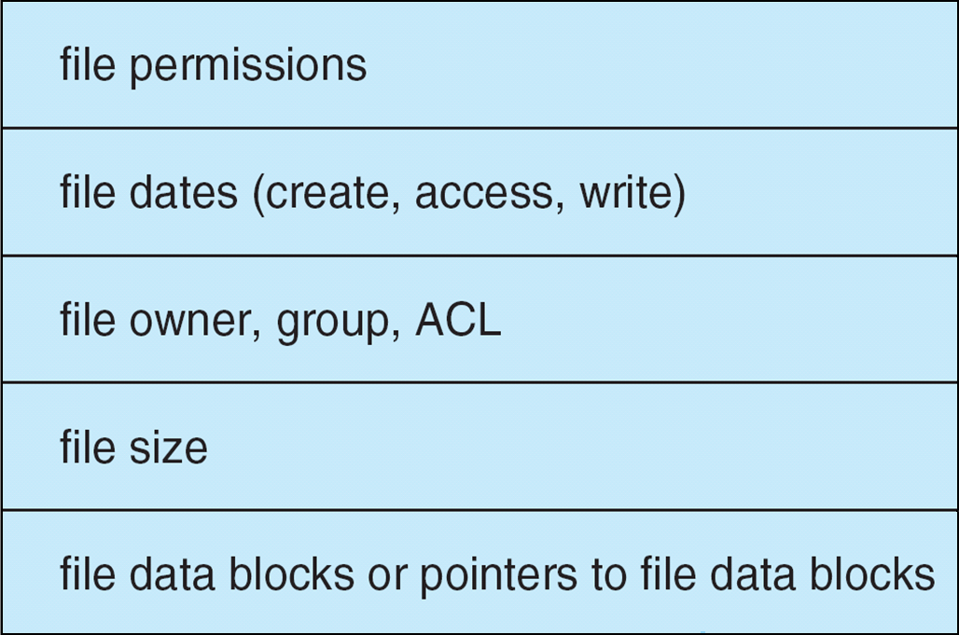
File-System Implementation (Cont.)
Per-file File Control Block (FCB) contains many details about the file
inode number, permissions, size, dates
NFTS stores into in master file table using relational DB structures

Slide 79
In-Memory File System Structures
Mount table storing file system mounts, mount points, file system types
The following figure illustrates the necessary file system structures provided by the operating systems
Figure (a) refers to opening a file
Figure (b) refers to reading a file
Plus buffers hold data blocks from secondary storage
Open returns a file handle for subsequent use
Data from read eventually copied to specified user process memory address

Slide 80
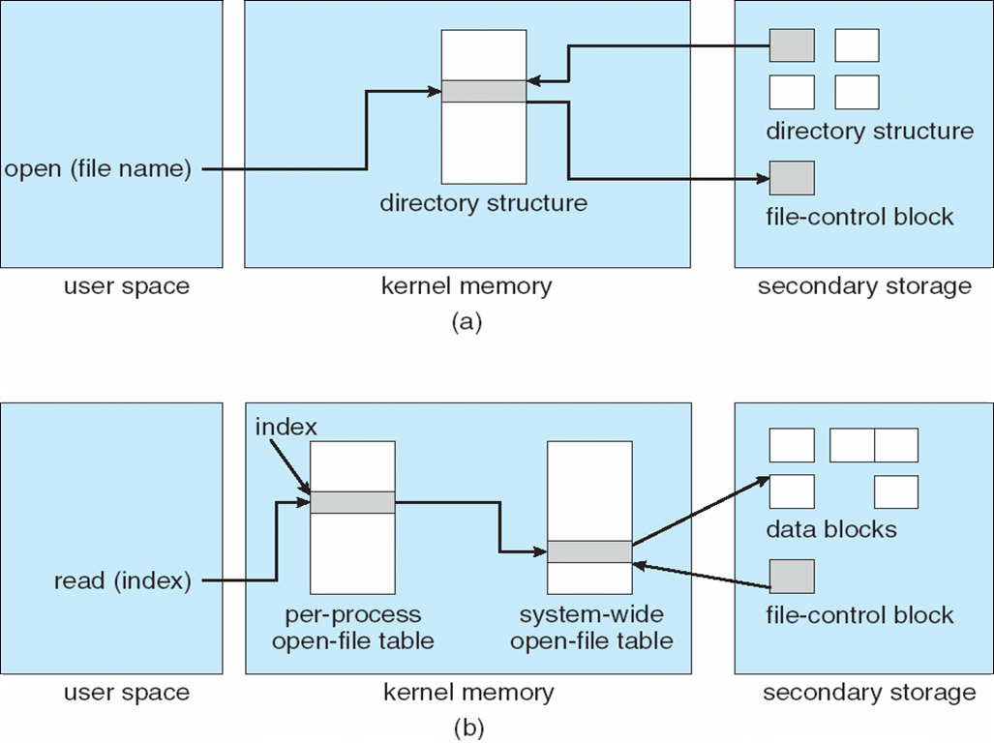
In-Memory File System Structures

Slide 81
Partitions and Mounting
Partition can be a volume containing a file system (“cooked”) or raw – just a sequence of blocks with no file system
Boot block can point to boot volume or boot loader set of blocks that contain enough code to know how to load the kernel from the file system
Or a boot management program for multi-os booting
Root partition contains the OS, other partitions can hold other Oses, other file systems, or be raw
Mounted at boot time
Other partitions can mount automatically or manually
At mount time, file system consistency checked
Is all metadata correct?
If not, fix it, try again
If yes, add to mount table, allow access

Slide 82
Virtual File Systems
Virtual File Systems (VFS) on Unix provide an object-oriented way of implementing file systems
VFS allows the same system call interface (the API) to be used for different types of file systems
Separates file-system generic operations from implementation details
Implementation can be one of many file systems types, or network file system
Implements vnodes which hold inodes or network file details
Then dispatches operation to appropriate file system implementation routines

Slide 83
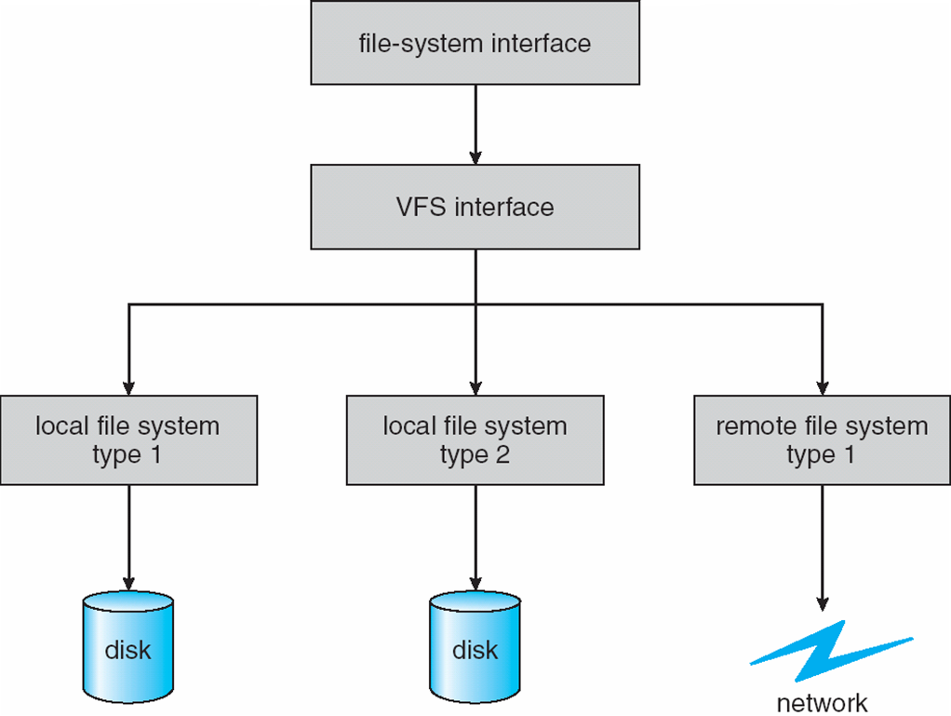
Virtual File Systems (Cont.)
The API is to the VFS interface, rather than any specific type of file system

Slide 84
Virtual File System Implementation
For example, Linux has four object types:
inode, file, superblock, dentry
VFS defines set of operations on the objects that must be implemented
Every object has a pointer to a function table
Function table has addresses of routines to implement that function on that object
For example:
• int open(. . .)—Open a file
• int close(. . .)—Close an already-open file
• ssize_t read(. . .)—Read from a file
• ssize_t write(. . .)—Write to a file
• int mmap(. . .)—Memory-map a file

Slide 85
Directory Implementation
Linear list of file names with pointer to the data blocks
Simple to program
Time-consuming to execute
Linear search time
Could keep ordered alphabetically via linked list or use B+ tree
Hash Table – linear list with hash data structure
Decreases directory search time
Collisions – situations where two file names hash to the same location
Only good if entries are fixed size, or use chained-overflow method

Slide 86
Allocation Methods - Contiguous
An allocation method refers to how disk blocks are allocated for files:
Contiguous allocation – each file occupies set of contiguous blocks
Best performance in most cases
Simple – only starting location (block #) and length (number of blocks) are required
Problems include finding space for file, knowing file size, external fragmentation, need for compaction off-line (downtime) or on-line

Slide 87
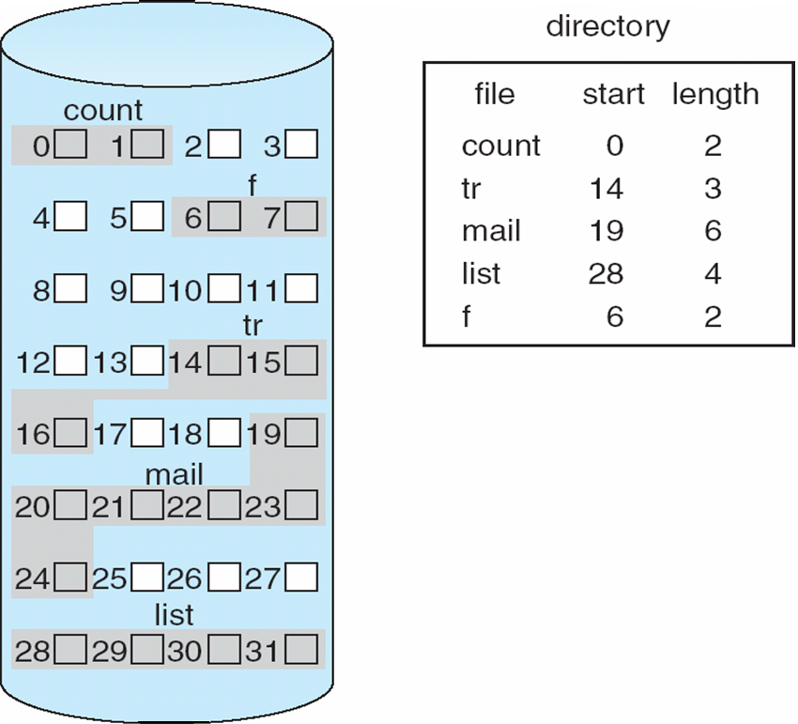
Contiguous Allocation
Mapping from logical to physical
Block to be accessed = Q + starting address
Displacement into block = R

Slide 88
Extent-Based Systems
Many newer file systems (i.e., Veritas File System) use a modified contiguous allocation scheme
Extent-based file systems allocate disk blocks in extents
An extent is a contiguous block of disks
Extents are allocated for file allocation
A file consists of one or more extents

Slide 89
Allocation Methods - Linked
Linked allocation – each file a linked list of blocks
File ends at nil pointer
No external fragmentation
Each block contains pointer to next block
No compaction, external fragmentation
Free space management system called when new block needed
Improve efficiency by clustering blocks into groups but increases internal fragmentation
Reliability can be a problem
Locating a block can take many I/Os and disk seeks

Slide 90
Allocation Methods – Linked (Cont.)
FAT (File Allocation Table) variation
Beginning of volume has table, indexed by block number
Much like a linked list, but faster on disk and cacheable
New block allocation simple

Slide 91
Linked Allocation
Each file is a linked list of disk blocks: blocks may be scattered anywhere on the disk
block =
pointer
Mapping
Q
LA/511
R
Block to be accessed is the Qth block in the linked chain of blocks representing the file.
Displacement into block = R + 1

Slide 92
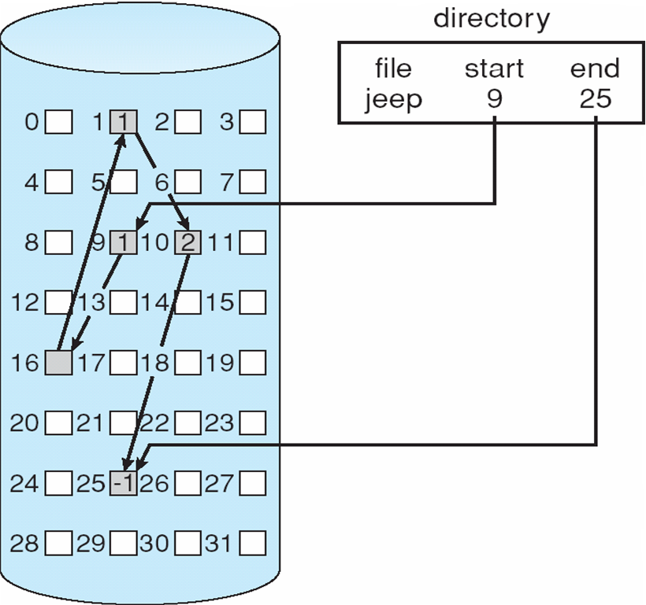
Linked Allocation

Slide 93
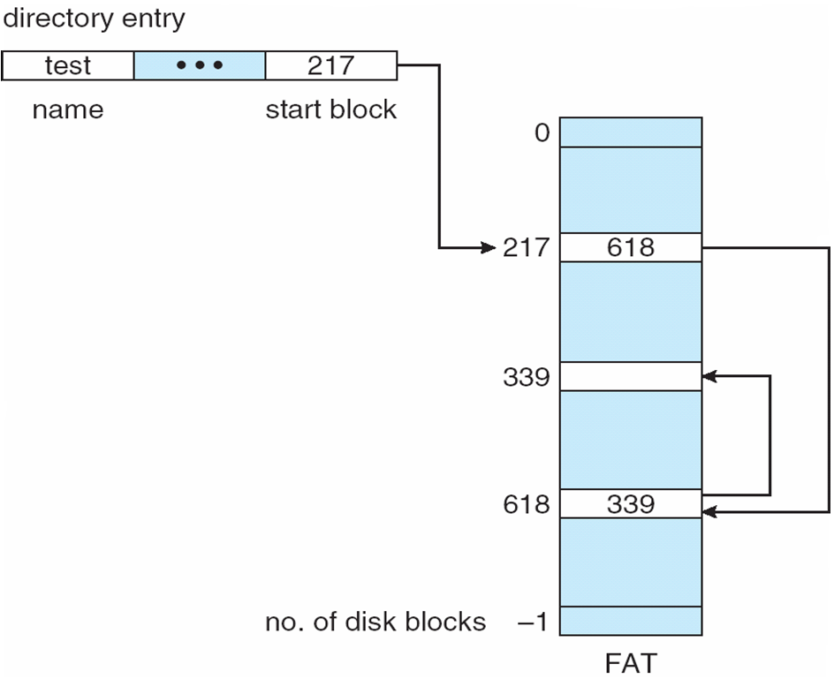
File-Allocation Table

Slide 94
Allocation Methods - Indexed
Indexed allocation
Each file has its own index block(s) of pointers to its data blocks
Logical view

Slide 95
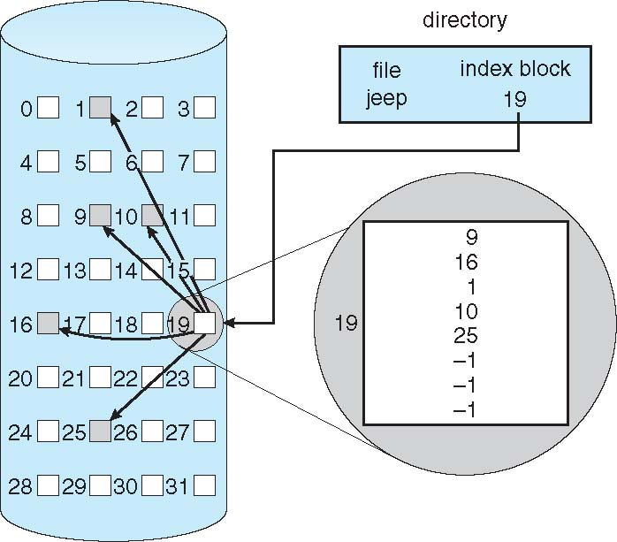
Example of Indexed Allocation

Slide 96
Indexed Allocation (Cont.)
Need index table
Random access
Dynamic access without external fragmentation, but have overhead of index block
Mapping from logical to physical in a file of maximum size of 256K bytes and block size of 512 bytes. We need only 1 block for index table

Slide 97
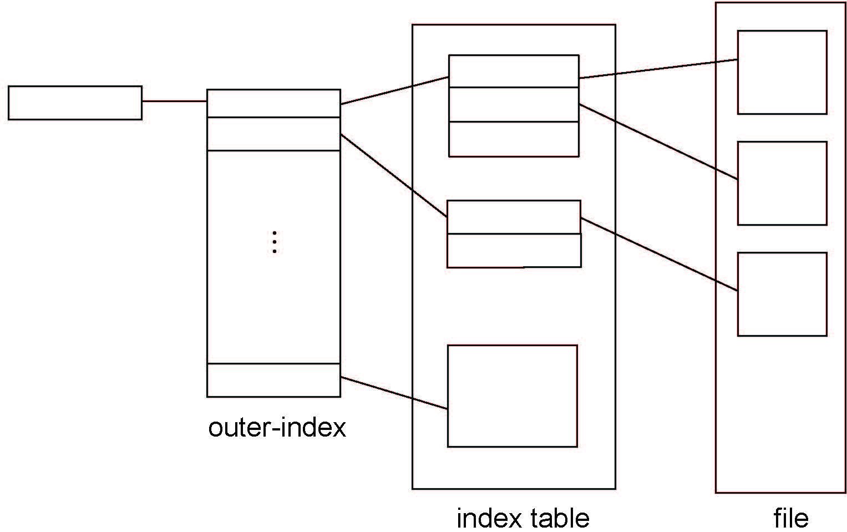
Indexed Allocation – Mapping (Cont.)

Slide 98
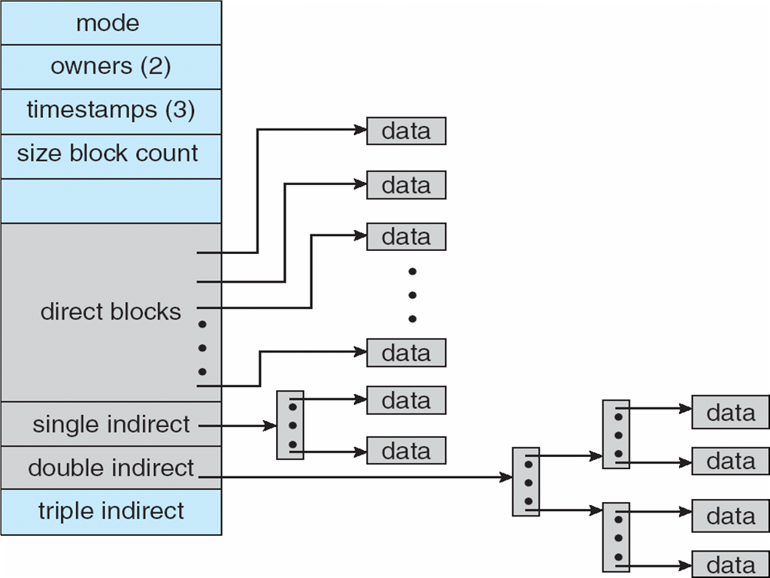
Combined Scheme: UNIX UFS
4K bytes per block, 32-bit addresses
More index blocks than can be addressed with 32-bit file pointer

Slide 99
Performance
Best method depends on file access type
Contiguous great for sequential and random
Linked good for sequential, not random
Declare access type at creation -> select either contiguous or linked
Indexed more complex
Single block access could require 2 index block reads then data block read
Clustering can help improve throughput, reduce CPU overhead

Slide 100
Free-Space Management
File system maintains free-space list to track available blocks/clusters
(Using term “block” for simplicity)
Bit vector or bit map (n blocks)
0
1
2
n-1
…
1 ⇒ block[i] free
0 ⇒ block[i] occupied
bit[i] =

Block number calculation
(number of bits per word) *
(number of 0-value words) +
offset of first 1 bit
CPUs have instructions to return offset within word of first “1” bit

Slide 101
Free-Space Management (Cont.)
Bit map requires extra space
Example:
block size = 4KB = 2¹² bytes
disk size = 2⁴⁰ bytes (1 terabyte)
n = 2⁴⁰/2¹² = 2²⁸ bits (or 32MB)
if clusters of 4 blocks -> 8MB of memory
Easy to get contiguous files

Slide 102
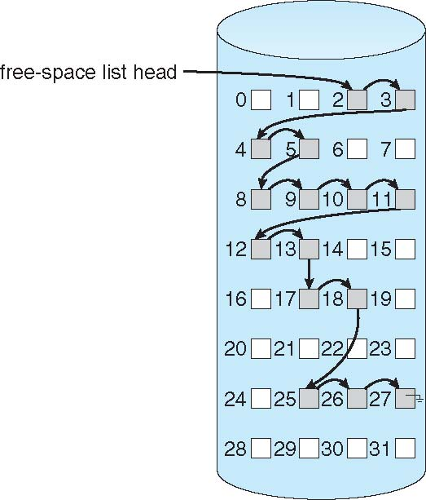
Linked Free Space List on Disk
Linked list (free list)
Cannot get contiguous space easily
No waste of space
No need to traverse the entire list (if # free blocks recorded)

Slide 103
Free-Space Management (Cont.)
Grouping
Modify linked list to store address of next n-1 free blocks in first free block, plus a pointer to next block that contains free-block-pointers (like this one)
Counting
Because space is frequently contiguously used and freed, with contiguous-allocation allocation, extents, or clustering
Keep address of first free block and count of following free blocks
Free space list then has entries containing addresses and counts

Slide 104
Efficiency and Performance
Efficiency dependent on:
Disk allocation and directory algorithms
Types of data kept in file’s directory entry
Pre-allocation or as-needed allocation of metadata structures
Fixed-size or varying-size data structures

Slide 105
Efficiency and Performance (Cont.)
Performance
Keeping data and metadata close together
Buffer cache – separate section of main memory for frequently used blocks
Synchronous writes sometimes requested by apps or needed by OS
No buffering / caching – writes must hit disk before acknowledgement
Asynchronous writes more common, buffer-able, faster
Free-behind and read-ahead – techniques to optimize sequential access
Reads frequently slower than writes

Slide 106
Page Cache
A page cache caches pages rather than disk blocks using virtual memory techniques and addresses
Memory-mapped I/O uses a page cache
Routine I/O through the file system uses the buffer (disk) cache
This leads to the following figure

Slide 107
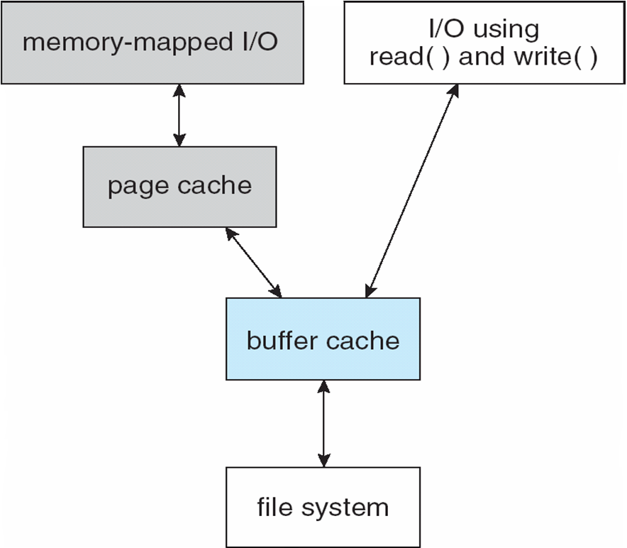
I/O Without a Unified Buffer Cache

Slide 108
Unified Buffer Cache
A unified buffer cache uses the same page cache to cache both memory-mapped pages and ordinary file system I/O to avoid double caching
But which caches get priority, and what replacement algorithms to use?

Slide 109
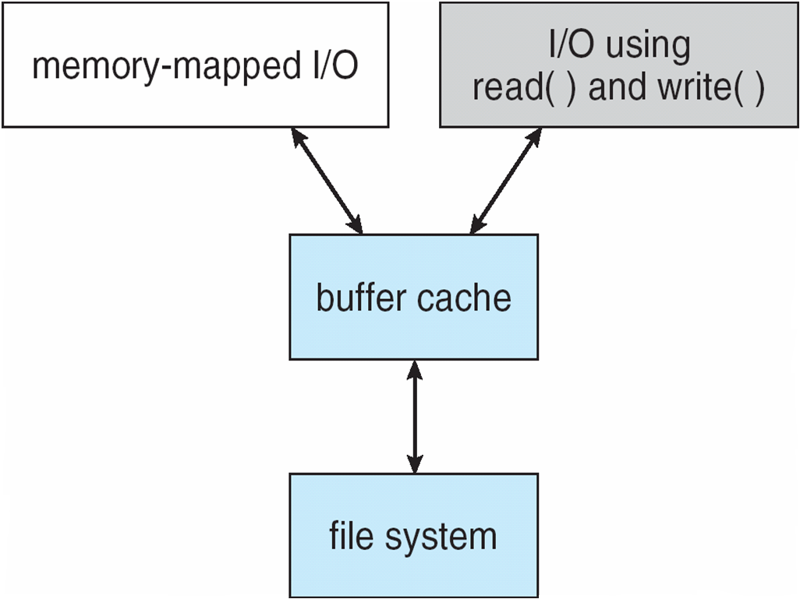
I/O Using a Unified Buffer Cache

Slide 110
Recovery
Consistency checking – compares data in directory structure with data blocks on disk, and tries to fix inconsistencies
Can be slow and sometimes fails
Use system programs to back up data from disk to another storage device (magnetic tape, other magnetic disk, optical)
Recover lost file or disk by restoring data from backup

Slide 111
Log Structured File Systems
Log structured (or journaling) file systems record each metadata update to the file system as a transaction
All transactions are written to a log
A transaction is considered committed once it is written to the log (sequentially)
Sometimes to a separate device or section of disk
However, the file system may not yet be updated
The transactions in the log are asynchronously written to the file system structures
When the file system structures are modified, the transaction is removed from the log
If the file system crashes, all remaining transactions in the log must still be performed
Faster recovery from crash, removes chance of inconsistency of metadata

Slide 112
Overview
I/O management is a major component of operating system design and operation
Important aspect of computer operation
I/O devices vary greatly
Various methods to control them
Performance management
New types of devices frequent
Ports, busses, device controllers connect to various devices
Device drivers encapsulate device details
Present uniform device-access interface to I/O subsystem

Slide 113
I/O Hardware
Incredible variety of I/O devices
Storage
Transmission
Human-interface
Common concepts – signals from I/O devices interface with computer
Port – connection point for device
Bus - daisy chain or shared direct access
PCI bus common in PCs and servers, PCI Express (PCIe)
expansion bus connects relatively slow devices
Controller (host adapter) – electronics that operate port, bus, device
Sometimes integrated
Sometimes separate circuit board (host adapter)
Contains processor, microcode, private memory, bus controller, etc
Some talk to per-device controller with bus controller, microcode, memory, etc

Slide 114
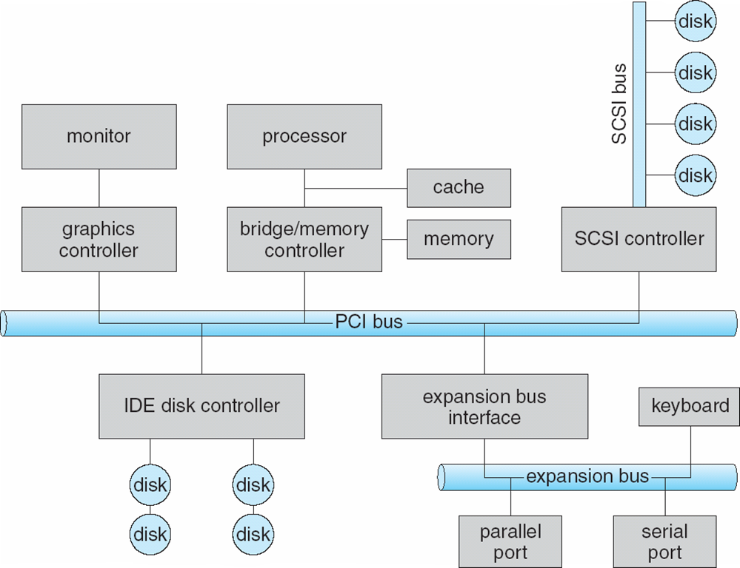
A Typical PC Bus Structure

Slide 115
I/O Hardware (Cont.)
I/O instructions control devices
Devices usually have registers where device driver places commands, addresses, and data to write, or read data from registers after command execution
Data-in register, data-out register, status register, control register
Typically 1-4 bytes, or FIFO buffer
Devices have addresses, used by
Direct I/O instructions
Memory-mapped I/O
Device data and command registers mapped to processor address space
Especially for large address spaces (graphics)

Slide 116
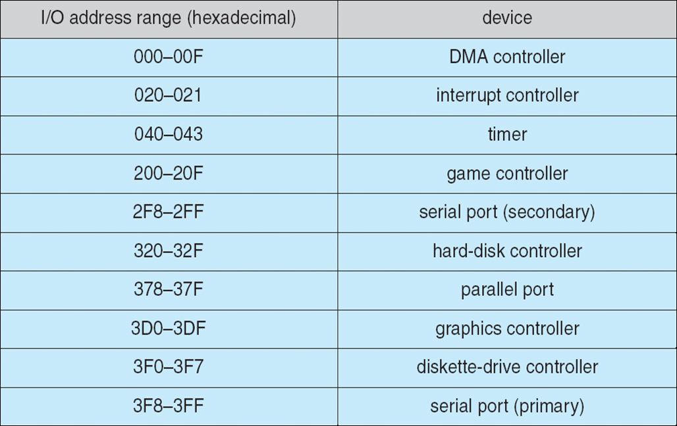
Device I/O Port Locations on PCs (partial)

Slide 117
Polling
For each byte of I/O
Read busy bit from status register until 0
Host sets read or write bit and if write copies data into data-out register
Host sets command-ready bit
Controller sets busy bit, executes transfer
Controller clears busy bit, error bit, command-ready bit when transfer done
Step 1 is busy-wait cycle to wait for I/O from device
Reasonable if device is fast
But inefficient if device slow
CPU switches to other tasks?
But if miss a cycle data overwritten / lost

Slide 118
Interrupts
Polling can happen in 3 instruction cycles
Read status, logical-and to extract status bit, branch if not zero
CPU Interrupt-request line triggered by I/O device
Checked by processor after each instruction
Interrupt handler receives interrupts
Maskable to ignore or delay some interrupts
Interrupt vector to dispatch interrupt to correct handler
This vector contains the memory addresses of specialized interrupt handlers
Context switch at start and end
Based on priority
Some nonmaskable
Interrupt chaining if more than one device at same interrupt number

Slide 119
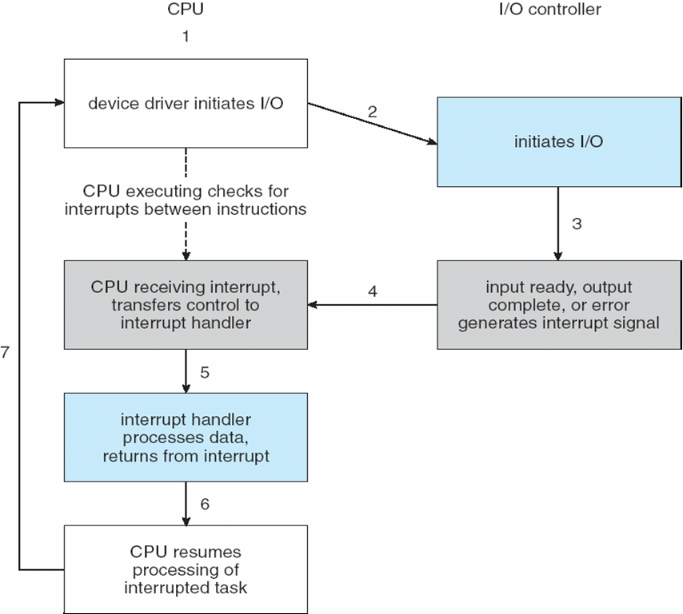
Interrupt-Driven I/O Cycle

Slide 120
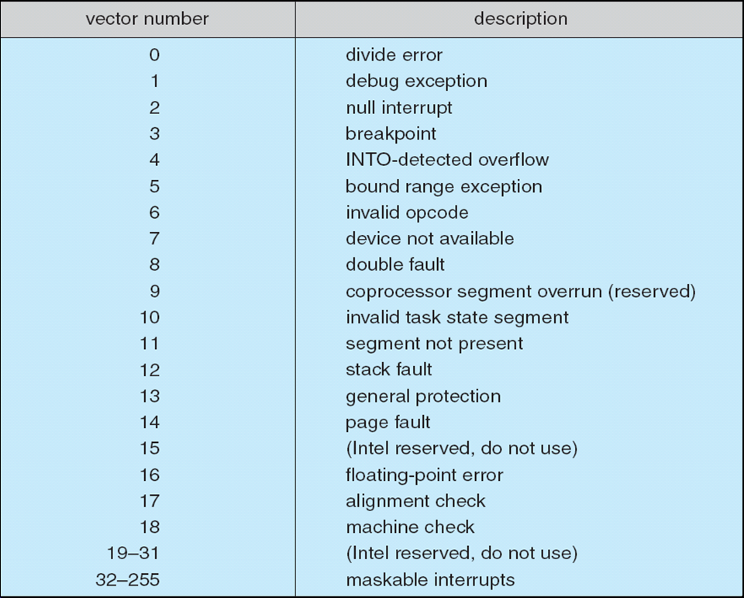
Intel Pentium Processor Event-Vector Table

Slide 121
Interrupts (Cont.)
Interrupt mechanism also used for exceptions
Terminate process, crash system due to hardware error
Page fault executes when memory access error
System call executes via trap to trigger kernel to execute request
Multi-CPU systems can process interrupts concurrently
If operating system designed to handle it
Used for time-sensitive processing, frequent, must be fast

Slide 122
Direct Memory Access
Used to avoid programmed I/O (one byte at a time) for large data movement
Requires DMA controller
Bypasses CPU to transfer data directly between I/O device and memory
OS writes DMA command block into memory
Source and destination addresses
Read or write mode
Count of bytes
Writes location of command block to DMA controller
Bus mastering of DMA controller – grabs bus from CPU
Cycle stealing from CPU but still much more efficient
When done, interrupts to signal completion
Version that is aware of virtual addresses can be even more efficient - DVMA

Slide 123
Six Step Process to Perform DMA Transfer

Slide 124
Application I/O Interface
I/O system calls encapsulate device behaviors in generic classes
Device-driver layer hides differences among I/O controllers from kernel
New devices talking already-implemented protocols need no extra work
Each OS has its own I/O subsystem structures and device driver frameworks
Devices vary in many dimensions
Character-stream or block
Sequential or random-access
Synchronous or asynchronous (or both)
Sharable or dedicated
Speed of operation
read-write, read only, or write only

Slide 125
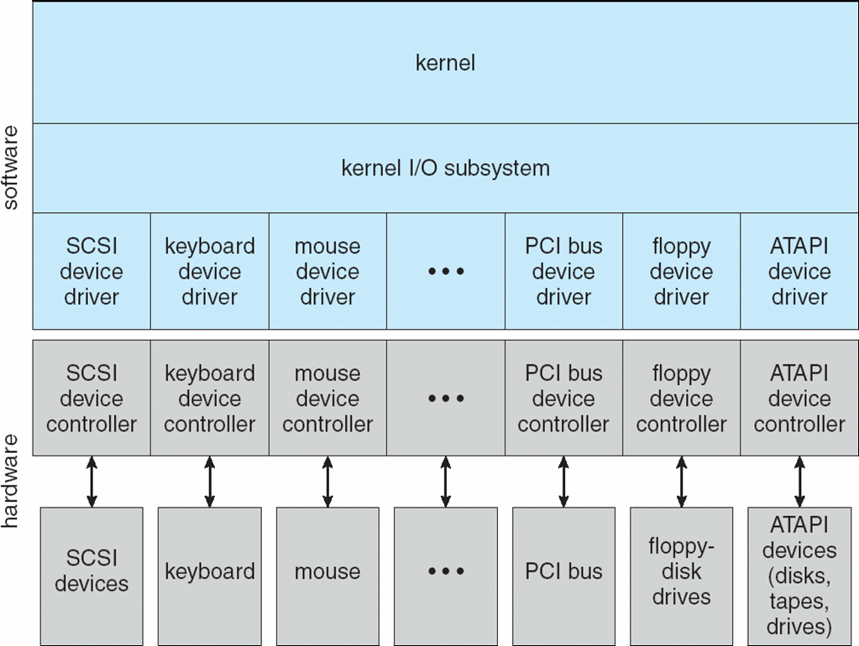
A Kernel I/O Structure

Slide 126
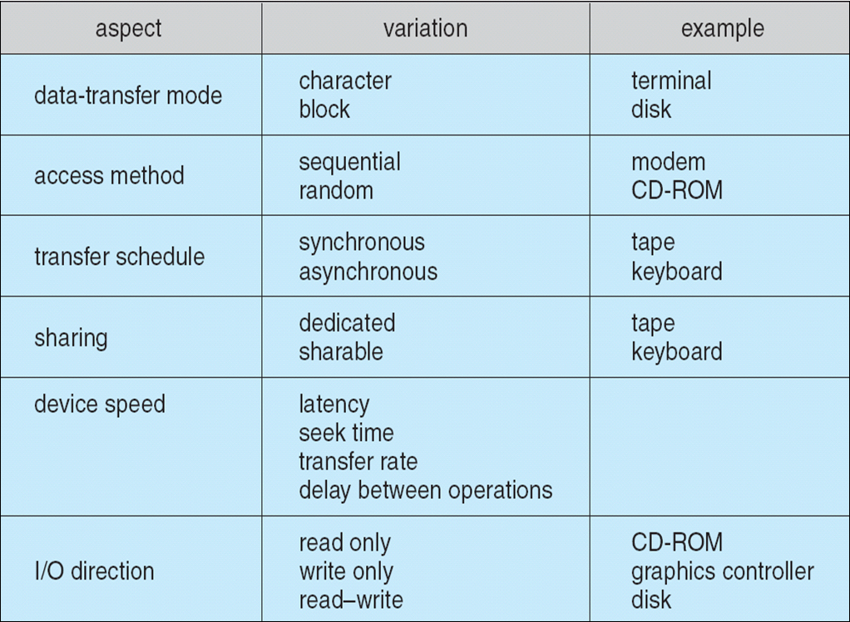
Characteristics of I/O Devices

Slide 127
Characteristics of I/O Devices (Cont.)
Subtleties of devices handled by device drivers
Broadly I/O devices can be grouped by the OS into
Block I/O
Character I/O (Stream)
Memory-mapped file access
Network sockets
For direct manipulation of I/O device specific characteristics, usually an escape / back door
Unix ioctl() call to send arbitrary bits to a device control register and data to device data register

Slide 128
Block and Character Devices
Block devices include disk drives
Commands include read, write, seek
Raw I/O, direct I/O, or file-system access
Memory-mapped file access possible
File mapped to virtual memory and clusters brought via demand paging
DMA
Character devices include keyboards, mice, serial ports
Commands include get(), put()
Libraries layered on top allow line editing

Slide 129
Network Devices
Varying enough from block and character to have own interface
Linux, Unix, Windows and many others include socket interface
Separates network protocol from network operation
Includes select() functionality
Approaches vary widely (pipes, FIFOs, streams, queues, mailboxes)

Slide 130
Clocks and Timers
Provide current time, elapsed time, timer
Normal resolution about 1/60 second
Some systems provide higher-resolution timers
Programmable interval timer used for timings, periodic interrupts
ioctl() (on UNIX) covers odd aspects of I/O such as clocks and timers

Slide 131
Nonblocking and Asynchronous I/O
Blocking - process suspended until I/O completed
Easy to use and understand
Insufficient for some needs
Nonblocking - I/O call returns as much as available
User interface, data copy (buffered I/O)
Implemented via multi-threading
Returns quickly with count of bytes read or written
select() to find if data ready then read() or write() to transfer
Asynchronous - process runs while I/O executes
Difficult to use
I/O subsystem signals process when I/O completed

Slide 132
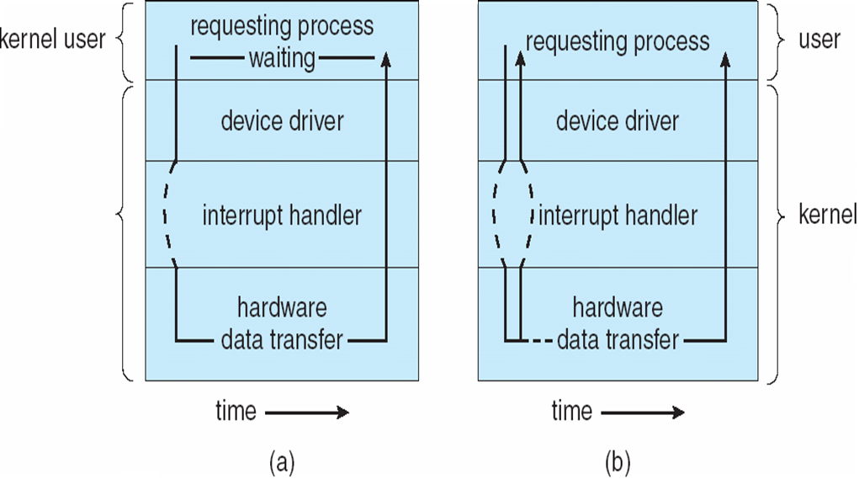
Two I/O Methods
Synchronous
Asynchronous

Slide 133
Vectored I/O
Vectored I/O allows one system call to perform multiple I/O operations
For example, Unix readve() accepts a vector of multiple buffers to read into or write from
This scatter-gather method better than multiple individual I/O calls
Decreases context switching and system call overhead
Some versions provide atomicity
Avoid for example worry about multiple threads changing data as reads / writes occurring

Slide 134
Kernel I/O Subsystem
Scheduling
Some I/O request ordering via per-device queue
Some OSs try fairness
Some implement Quality Of Service (i.e. IPQOS)
Buffering - store data in memory while transferring between devices
To cope with device speed mismatch
To cope with device transfer size mismatch
To maintain “copy semantics”
Double buffering – two copies of the data
Kernel and user
Varying sizes
Full / being processed and not-full / being used
Copy-on-write can be used for efficiency in some cases

Slide 135
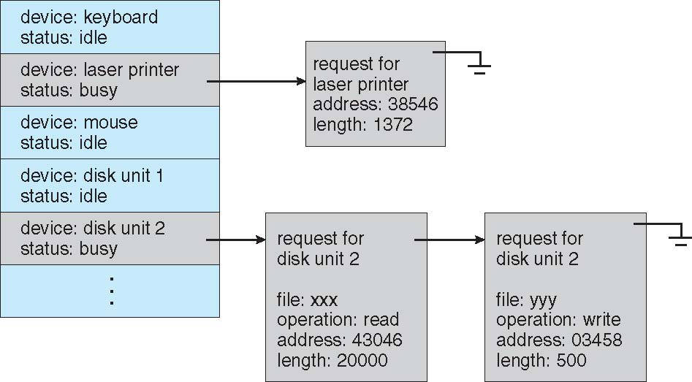
Device-status Table

Slide 136
Kernel I/O Subsystem
Caching - faster device holding copy of data
Always just a copy
Key to performance
Sometimes combined with buffering
Spooling - hold output for a device
If device can serve only one request at a time
i.e., Printing
Device reservation - provides exclusive access to a device
System calls for allocation and de-allocation
Watch out for deadlock

Slide 137
Error Handling
OS can recover from disk read, device unavailable, transient write failures
Retry a read or write, for example
Some systems more advanced – Solaris FMA, AIX
Track error frequencies, stop using device with increasing frequency of retry-able errors
Most return an error number or code when I/O request fails
System error logs hold problem reports

Slide 138
I/O Protection
User process may accidentally or purposefully attempt to disrupt normal operation via illegal I/O instructions
All I/O instructions defined to be privileged
I/O must be performed via system calls
Memory-mapped and I/O port memory locations must be protected too

Slide 139
Use of a System Call to Perform I/O

Slide 140
Kernel Data Structures
Kernel keeps state info for I/O components, including open file tables, network connections, character device state
Many, many complex data structures to track buffers, memory allocation, “dirty” blocks
Some use object-oriented methods and message passing to implement I/O
Windows uses message passing
Message with I/O information passed from user mode into kernel
Message modified as it flows through to device driver and back to process
Pros / cons?
The message-passing approach can add overhead, by comparison with procedural techniques that use shared data structures, but it simplifies the structure and design of the I/O system and adds flexibility

Slide 141
Power Management
Not strictly domain of I/O, but much is I/O related
Computers and devices use electricity, generate heat, frequently require cooling
OSes can help manage and improve use
Cloud computing environments move virtual machines between servers
Can end up evacuating whole systems and shutting them down
Mobile computing has power management as first class OS aspect

Slide 142
Power Management (Cont.)
For example, Android implements
Component-level power management
Understands relationship between components
Build device tree representing physical device topology
System bus -> I/O subsystem -> {flash, USB storage}
Device driver tracks state of device, whether in use
Unused component – turn it off
All devices in tree branch unused – turn off branch
Wake locks – like other locks but prevent sleep of device when lock is held
Power collapse – put a device into very deep sleep
Marginal power use
Only awake enough to respond to external stimuli (button press, incoming call)

Slide 143
I/O Requests to Hardware Operations
Consider reading a file from disk for a process:
Determine device holding file
Translate name to device representation
Physically read data from disk into buffer
Make data available to requesting process
Return control to process

Slide 144
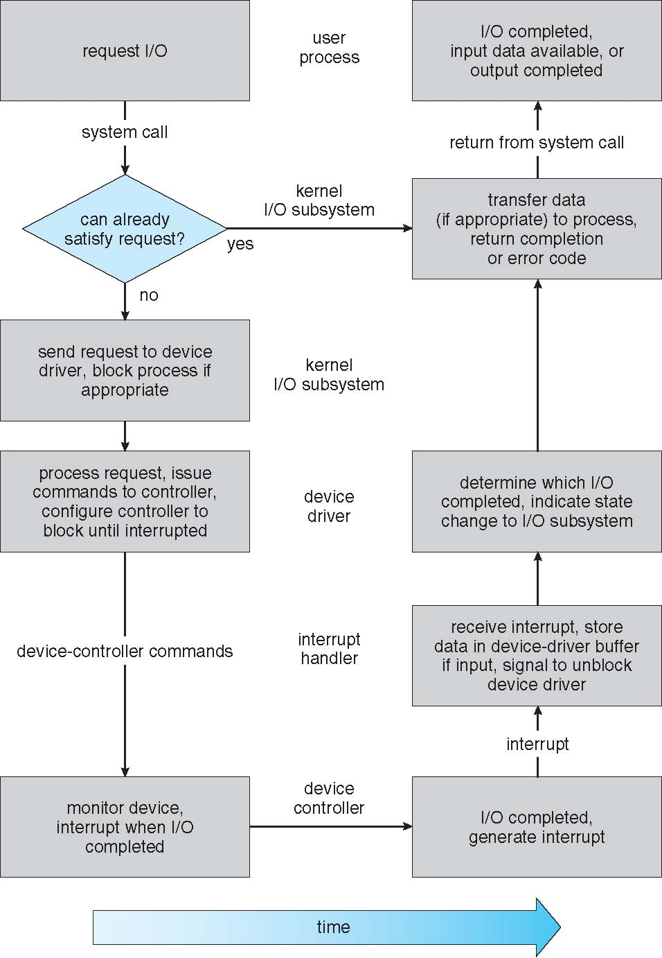
Life Cycle of An I/O Request

Slide 145
STREAMS
STREAM – a full-duplex communication channel between a user-level process and a device in Unix System V and beyond
A STREAM consists of:
STREAM head interfaces with the user process
driver end interfaces with the device
zero or more STREAM modules between them
Each module contains a read queue and a write queue
Message passing is used to communicate between queues
Flow control option to indicate available or busy
Asynchronous internally, synchronous where user process communicates with stream head

Slide 146
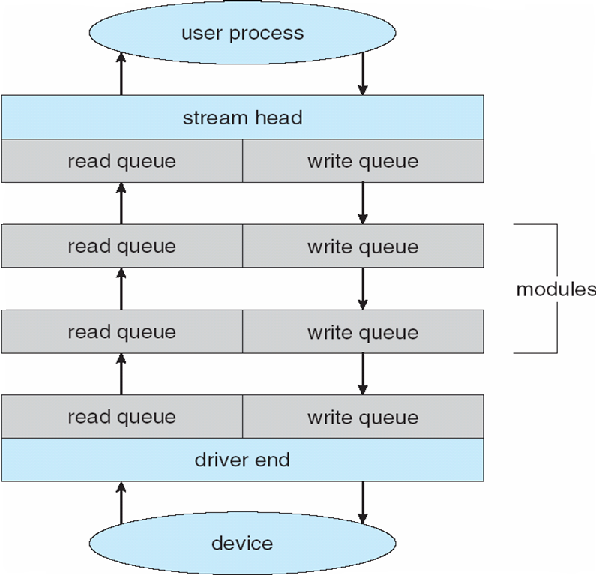
The STREAMS Structure

Slide 147
Performance
I/O a major factor in system performance:
Demands CPU to execute device driver, kernel I/O code
Context switches due to interrupts
Data copying
Network traffic especially stressful

Slide 148
Intercomputer Communications

Slide 149
Improving Performance
Reduce number of context switches
Reduce data copying
Reduce interrupts by using large transfers, smart controllers, polling
Use DMA
Use smarter hardware devices
Balance CPU, memory, bus, and I/O performance for highest throughput
Move user-mode processes / daemons to kernel threads

Slide 150
Device-Functionality Progression

Slide 151
Source and Acknowledgement
Operating System Concepts, Ninth Edition, A. Silberschatz, Peter Baer Galvin and G. Gagne.
https://www.os-book.com/OS9/slide-dir/index.html

